Slide 1
Consumer Products Review Site
Melinda Fraser
Capstone 2
9-29-2020
Notes:
Good Morning team,
I was tasked with reviewing the data from the EPA on several hundred thousand vehicles. The goal was to see what Consumer Products Review Site should recommend on their website.

Slide 2

Average MPG and Annual Fuel Cost
Drives consumer choices
Saves money
Demonstrates efficiency
Notes:
The focus is maximum Average MPG and minimum Annual Fuel Cost. These are key factors in considering a vehicle for purchase. The consumer typically wants to know how economical the vehicles they are looking at are. This demonstrates to the consumer the efficiency of the car, and the overall cost of the car. Especially during these times of climate change and resource scarcity, it is important for the average consumer to have a vehicle that will “keep on truckin” for maximum amount of time.

Slide 3
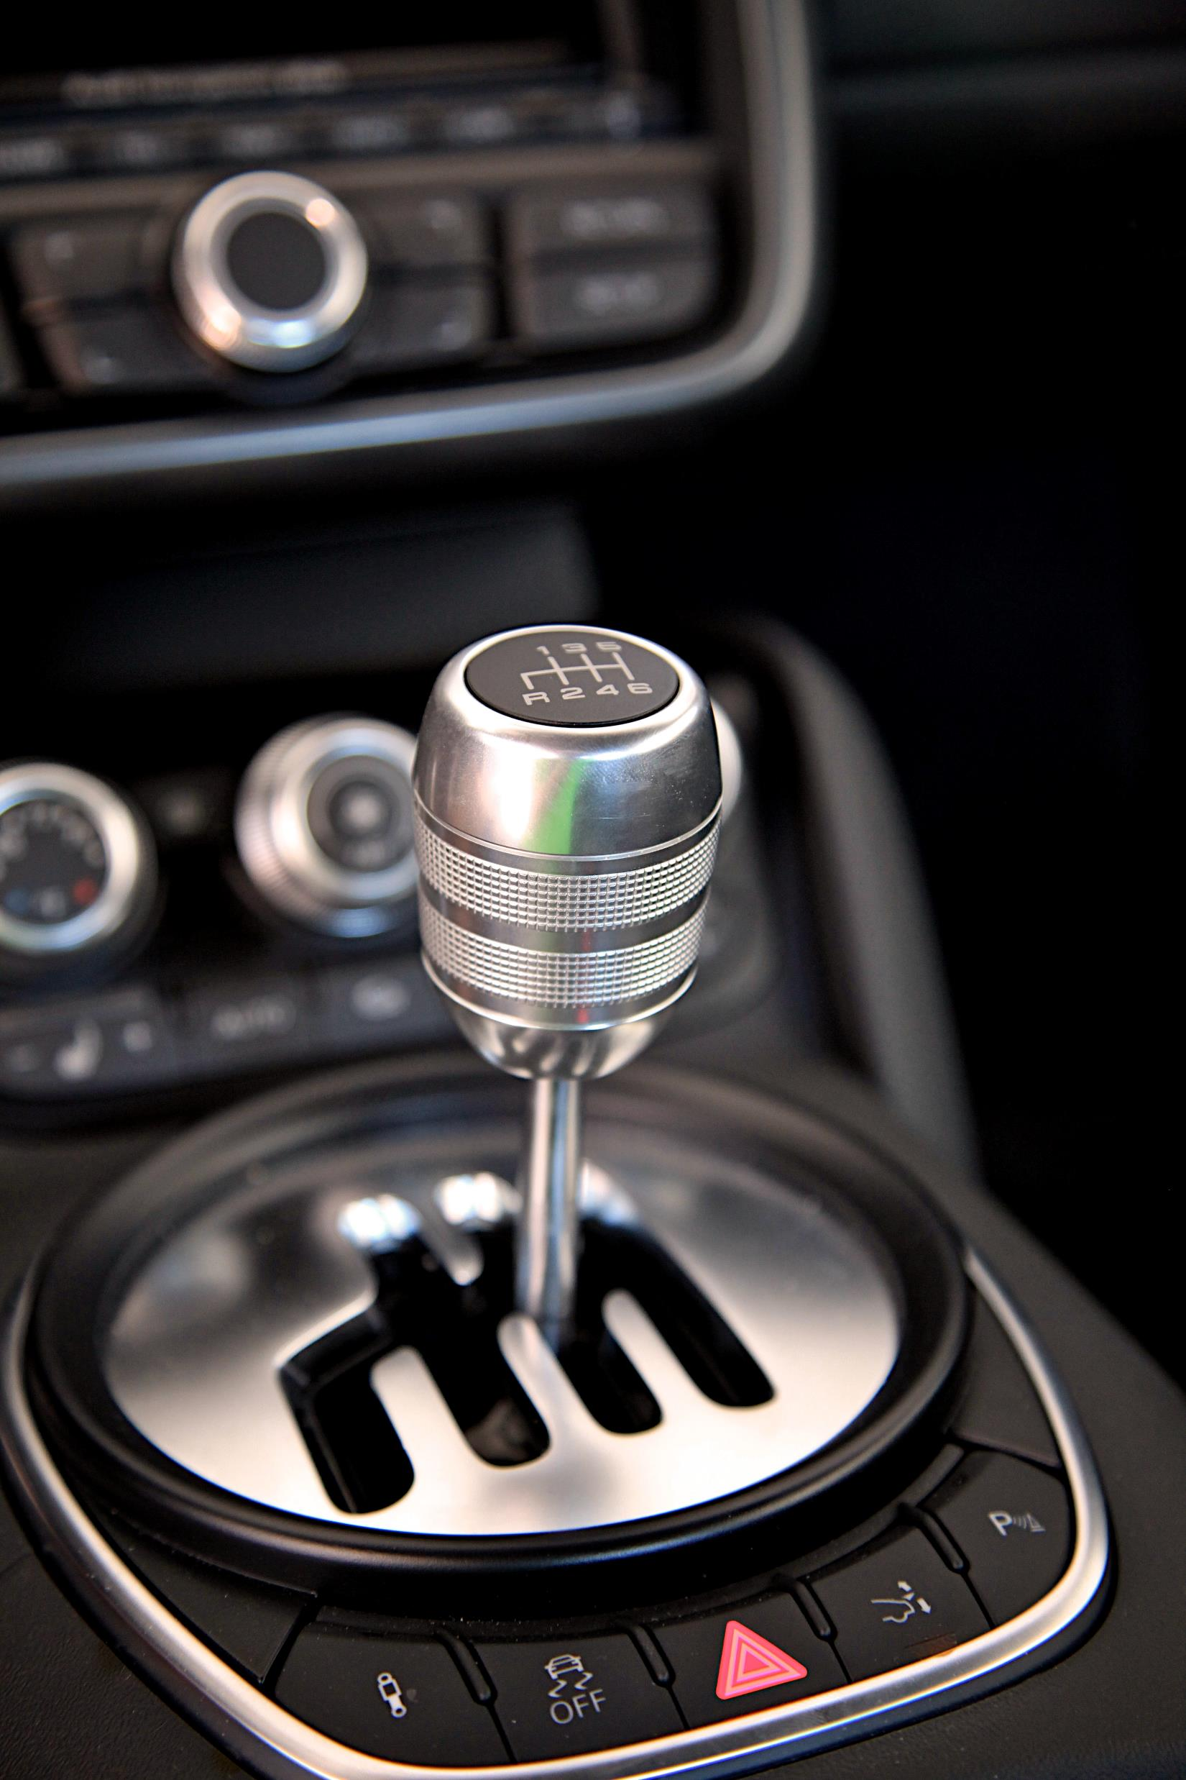
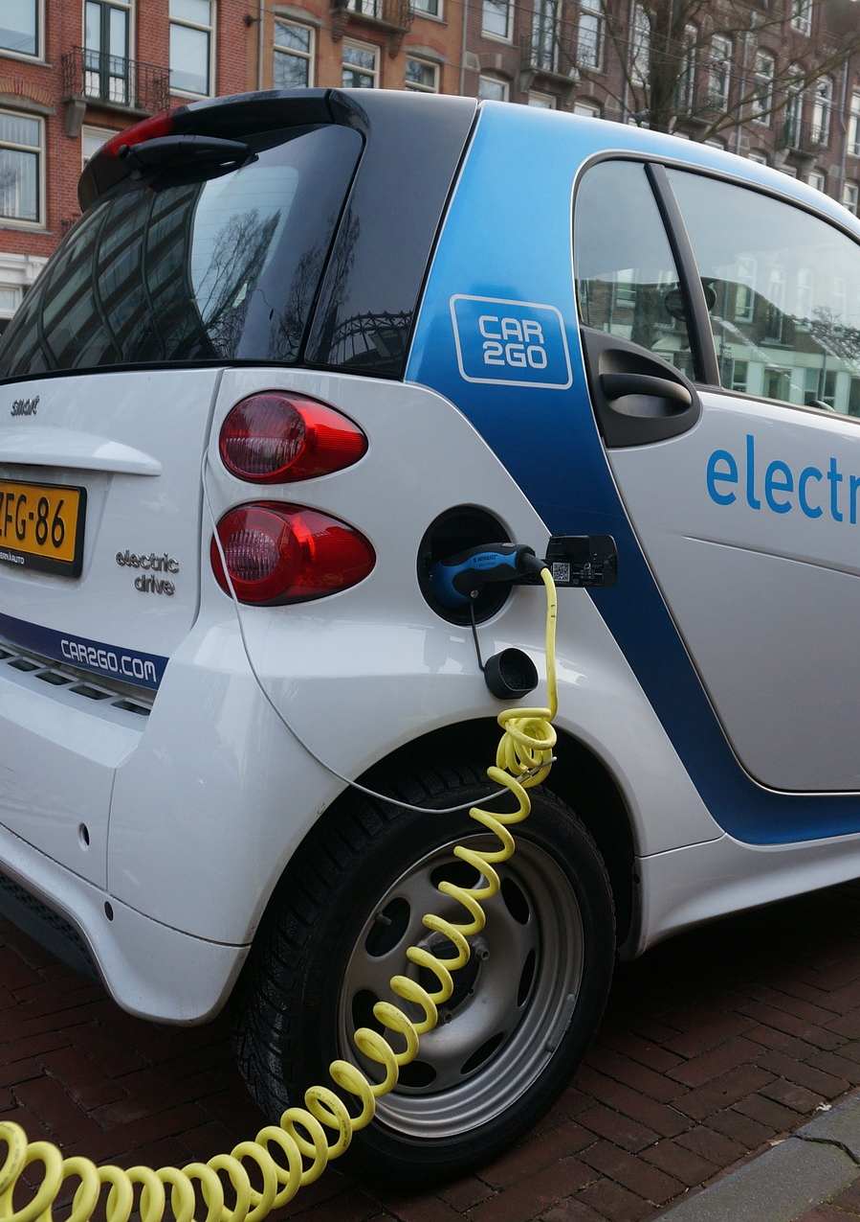
Hypotheses
Electric/Hybrid more efficient than Gas
Manual more efficient than Automatic
Typical engine size more efficient than larger or smaller
Notes:
After reviewing the data which included: year, make, model, engine type, engine size, fuel type, and transmission, amongst several other specifics, I drew my hypothesis. Based on my own personal knowledge of vehicles, I hypothesize that electric or hybrid vehicles are more efficient (as in they have high MPG (for combined city and highway use) and low annual fuel cost) than fossil fuel only vehicles. Electric is marketed as cleaner and longer lasting than gas fuel. And manual transmission is more efficient than automatic. Here the underlying thought being – manual can be changed to suit the speed and driving conditions for maximum efficiency, whereas automatic is an automatic programming that isn’t necessarily ideal for the driving condition. Finally, the third hypothesis is that the smaller the engine size, the lighter the load, and thus the more efficient the vehicle would be.

Slide 4
Data Points
Environmental Protection Agency's National Vehicle and Fuel Emissions Laboratory in Ann Arbor, Michigan
Efficiency rates are proportions, not continuous variable
Notes:
The data I reviewed comes from the EPA laboratory in Ann Arbor, Michigan. This possibly means the data is skewed overall for conditions of this area – snow in winter, mild but humid summers.
The efficiency rates of MPG and annual fuel cost are proportions of miles over gallons and dollars over time, respectively. These data points are normally distributed.

Slide 5
Method
Divide into groups (using Pivot Tables)
Independent-Samples T-Tests for A/B testing (Analysis Toolpak)
Error bar graphs
Notes:
In order to analyze these hypotheses, I made sure to group the data I was reviewing into two groups for every hypothesis. For example, I was not interested in how many gears the manual shifted into, but only wanted all the manuals classed together. Additionally, for the engine sizes I ended up classing them by displacement. The typical displacement for an engine being 2L, give or take .5L, and the rest of the engine sizes were classed as specialized-sizes. I grouped the data using Pivot Tables to get values for each hypothesis set by make. I then did descriptive analysis and t-tests for each of these 3 data sets to see if they were statistically significant.

Slide 6
Automatic vs Manual
No manual option for electric vehicles
Smaller significance
With 95% confidence, the difference is between 28115 and 29415 difference in means for annual fuel cost
With 95% confidence, the difference is between -8.1 and 1.2 difference in means for MPG.
Notes:
My first hypothesis is automatic vs manual transmission. The most striking revelation of this data is that there are no manual electric or hybrid vehicles. At least in this dataset. This comparison is purely for gas fuel vehicles. With that being said, we can see on the error bars that the statistical difference is fairly small. However, The t-test analysis for annual fuel cost that This difference is significant at the <.05 level.. And for the MPG, This difference is significant at the <.05 level. While small, there is a statistical significance in the differences between automatic and manual, and my hypothesis was proven correct.

Slide 7
Electric vs Gas
Very large significance of change
With 95% confidence, the difference is between 142447 and 143614 difference in means for annual cost
With 95% confidence, the difference is between -1035 and -989 difference in means for MPG.
Notes:
For electric and hybrid vs gas fuel vehicles the difference in very obvious in the error bars. We can clearly see that there is a large statistical significance in both annual cost of fuel and mpg. The t-tests for each verify this: This difference is significant at the <.05 level. With 95% confidence, the difference is between 142447 and 143614 difference in means for annual cost. And This difference is significant at the <.05 levelMy hypothesis for this dataset was proven true.

Slide 8
Typical vs Specialized Engine Size
Large Significance
With 95% confidence, the difference is between -243575 and -242669 difference in means in annual fuel cost.
With 95% confidence, the difference is between -.89 and 4.94 difference in means for MPG.
Notes:
The final hypothesis of typical sized engine displacement versus specialized size (which is outside the average of 1.5-2.5L) is also proven true. Here again, we can see with the error bars that there is a significant statistical difference between the two data sets

Slide 9
Insights
Electric vs Gas is significant increase in efficiency
Manual vs Automatic is slight increase – only effects Gas vehicles
Notes:
With the statisitical analysis having proven my hypotheses I am confident in sharing these insights: Electric and hybrid vehicles are by far the most fuel efficient in both annual cost and city and highway MPG. In this pivot chart we can see that electric and hybrid vehicles of average engine size save the consumer just under $2k over 5 years. This is a great point to emphasize in consumer reporting. Gas fuel vehicles of average engine size and with manual transmission cost the user the least amount over 5 years at $1200. Then automatic comes second at a $20 dollar a year increase in cost. The least efficient combinations are electric and hybrid vehicles with specialized engines at a loss of $1600 over 5 years, and finally specialicty sized engines for gas fuel vehicles for both automatic and manual transmissions COST the consumer over $4k over 5 years.

Slide 10

Recommendations
Promote Electric or Hybrid vehicles
Secondary promotion is manual vehicles
Third promotion is typical Engine Size (1.6L-2.5L displacement)

